Slide 1
Feedback weekly assignment #2
28 Nov 2022

Slide 2
Constructs – re-occurring mistakes
1) Constructs defined as abstract phenomena that cannot be operationalized
reasons not to participate in the platform-to-platform openness
digital platform business model
prerequisites for a company to be successful
Variables that can be directly observed
Or parts from the theory
2) The construct is defined circularly to some extent
- Customer trust: Amount of faith a customer has in the platform that has access to its data
- Motivation to share data: A business’ willingness to openly share data on the platform
3) Many dependent variables are missing as a construct

Slide 3
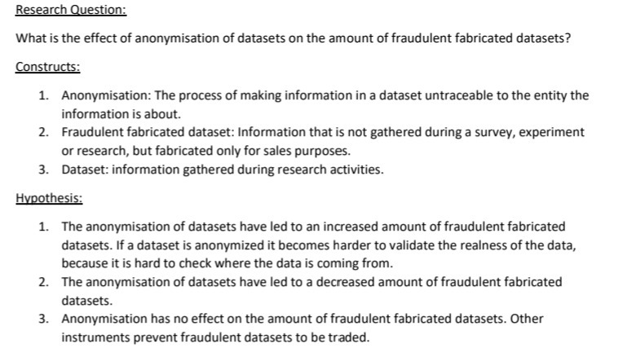
Tip - Constructs
Constructs presented are objects and processes, not concepts as intended (“security”, “privacy”, “trust”)

Slide 4
Unit of analysis
1) The unit of analysis is the major entity being studied
For instance: Organization, consumer, team, industry
So it is not
Practices used by companies to optimize the data validity
Customer trust as well as confidence and comfort with which the customer shares its data with a platform
The Business Model of Data Platforms

Slide 5
Hypothesis – frequent mistakes
1) Constructs are not connected; cannot answer the main research question
2) A technology is in the hypotheses
- The risk mapping tool positively moderates the relation between the assessment of risks and the openness on business data
→ Only put constructs = property of a unit of analysis

Slide 6
Hypothesis
Hypothesis is always the basis of your research!
Good practice:
Directional:
The success of printed products (number of sales) will be higher when customer satisfaction is higher.
Introduction of green hydrogen in the transportation sector has a positive impact on reducing GHG.
Non-directional:
Perception of the ease of use of the electric vehicles among users has an impact on their perception on the e-mobility in general.

Slide 7
Internal validity (many problems with this)
1) Criteria should be discussed rather than only mentioned
- the experience to share data and the openness of data should co-vary
2) Relate the internal validity discussion to the chosen research strategy, criteria differ per research strategy, also explain how you want to guarantee internal validity

Slide 8
Unit of analysis and research strategy
Unit of analysis:
Should always match up with research question
If your research question is about a dryer unit than the unit of analysis is the dryer unit, not the full production process
Research strategy:
Mostly used: Case study
Make sure to have a clear explanation of why you chose your strategy.
Only stating that you should collect data is too limited
Incorporate internal validity in the explanation

